Slide 1
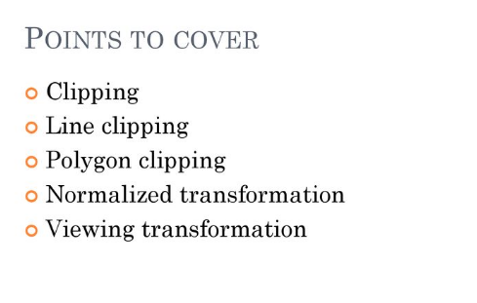
Windowing and clipping

Slide 2
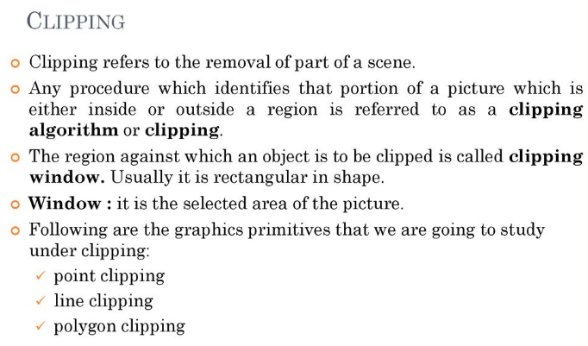
Windowing and clipping

Slide 3
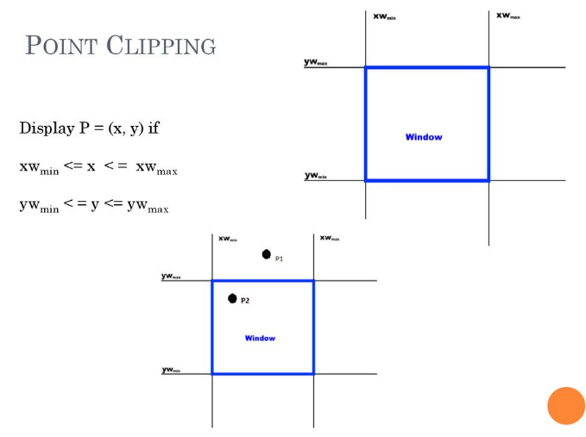
Windowing and clipping

Slide 4
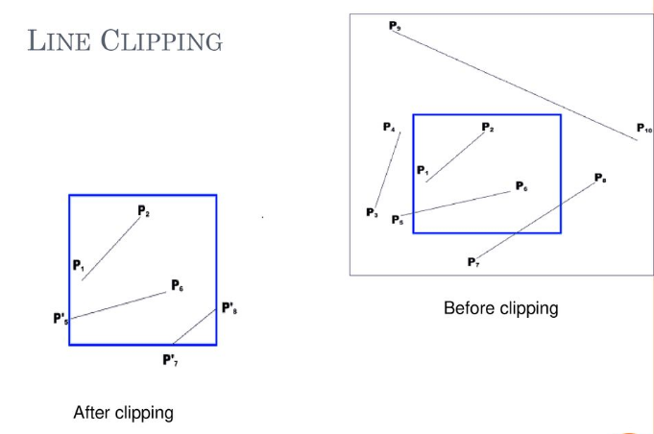
Windowing and clipping

Slide 5
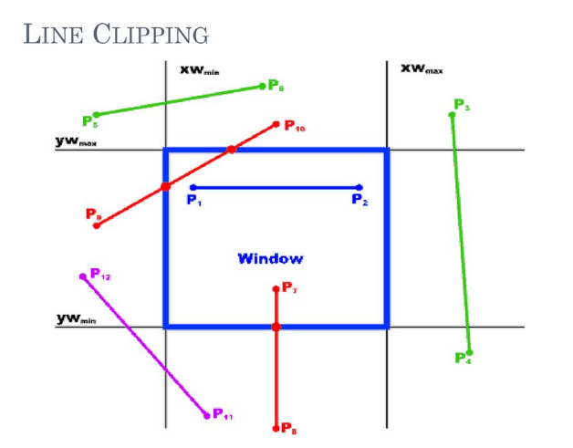
Windowing and clipping

Slide 6

Windowing and clipping

Slide 7
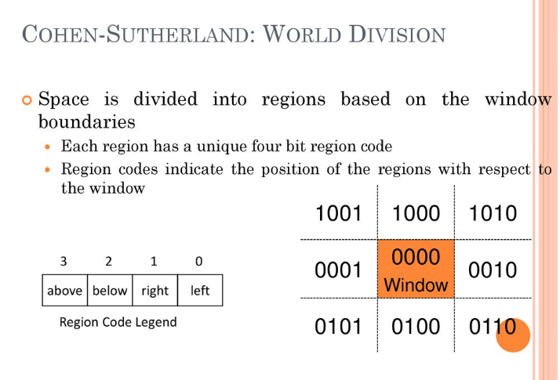
Windowing and clipping

Slide 8
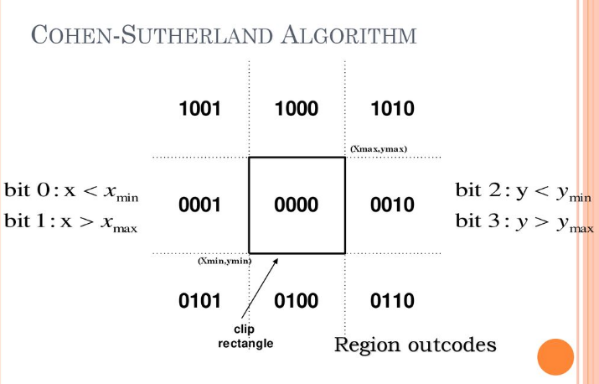
Windowing and clipping

Slide 9
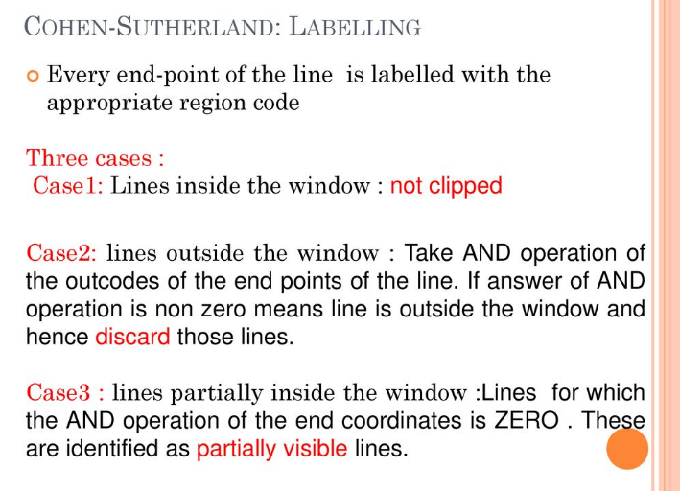
Windowing and clipping

Slide 10
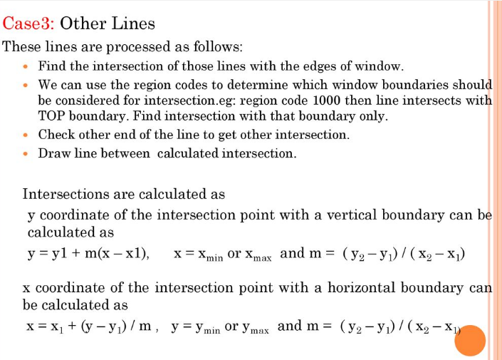
Windowing and clipping

Slide 11
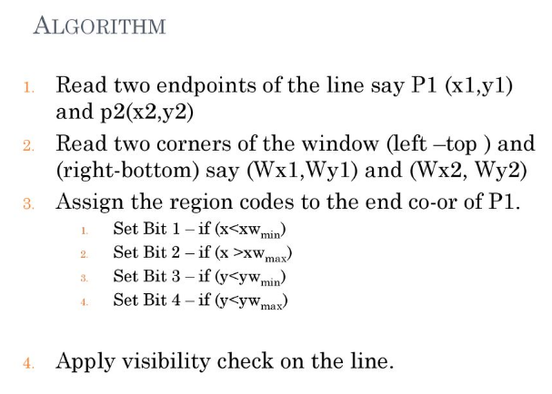
Windowing and clipping

Slide 12
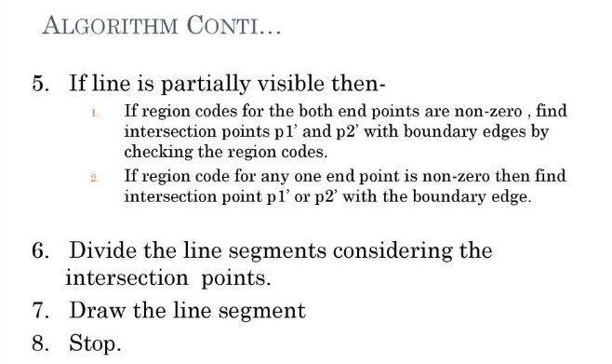
Windowing and clipping

Slide 13
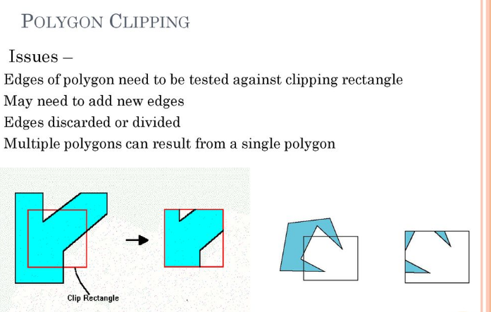
Windowing and clipping

Slide 14

Windowing and clipping

Slide 15
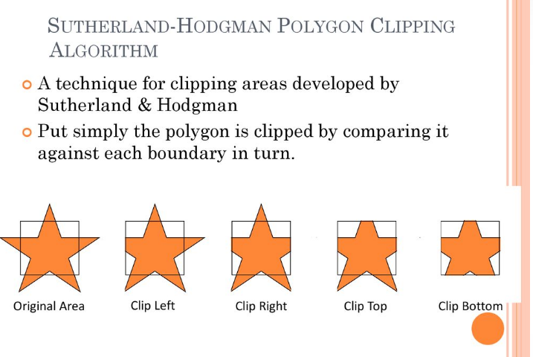
Windowing and clipping

Slide 16
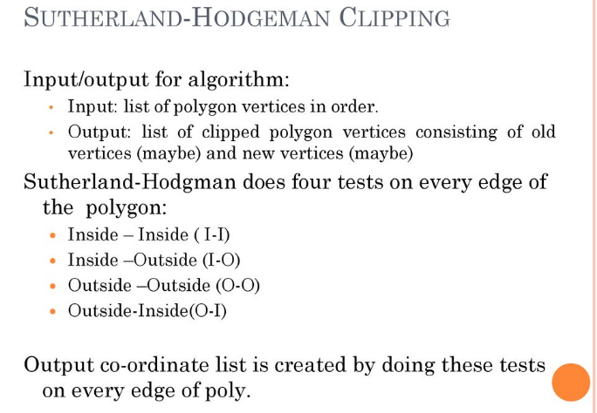
Windowing and clipping

Slide 17
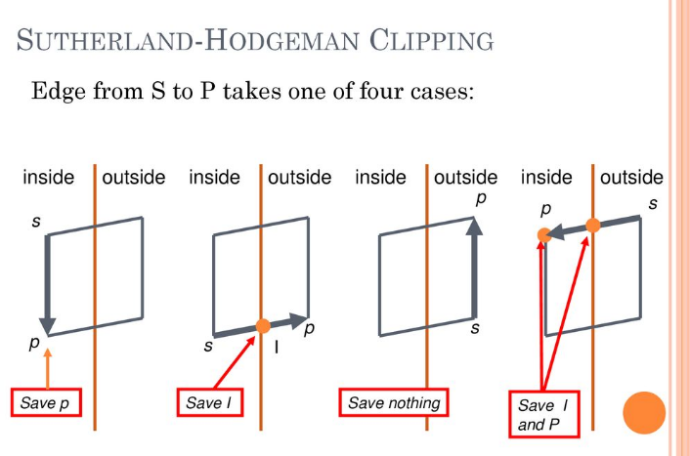
Windowing and clipping

Slide 18
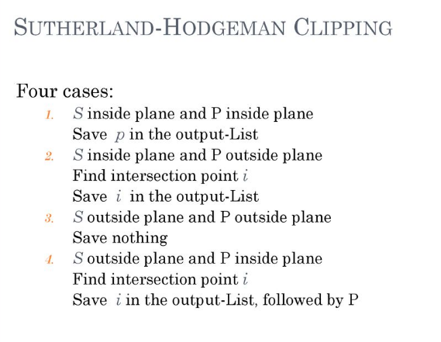
Windowing and clipping

Slide 19
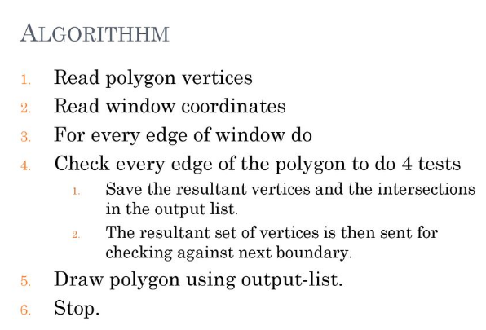
Windowing and clipping

Slide 20
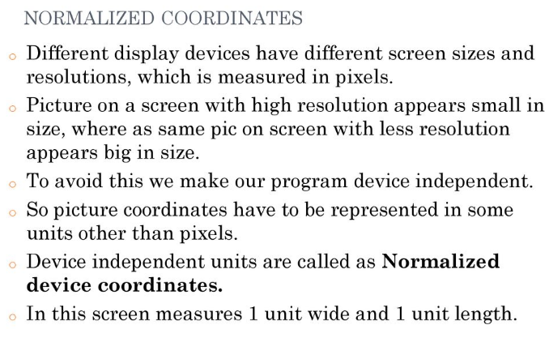
Windowing and clipping

Slide 21
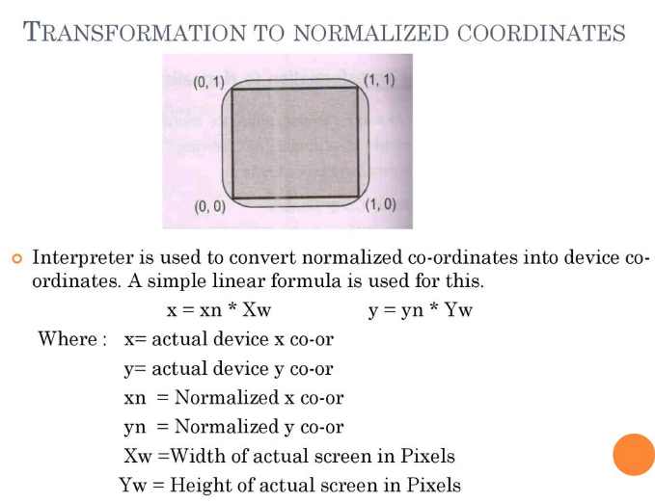
Windowing and clipping

Slide 22
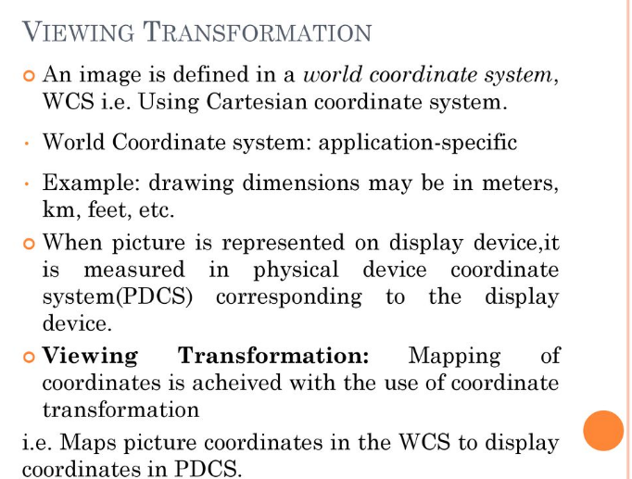
Windowing and clipping

Slide 23
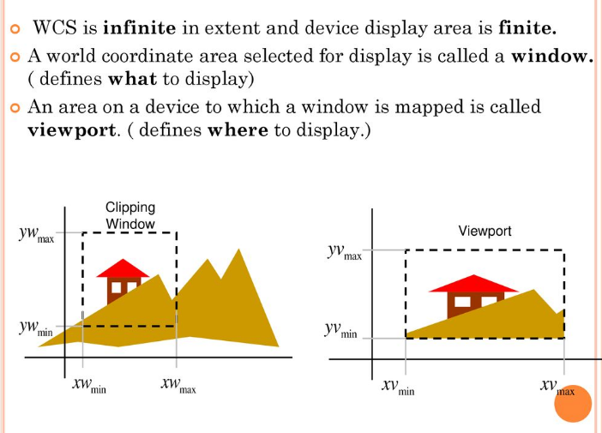
Windowing and clipping

Slide 24
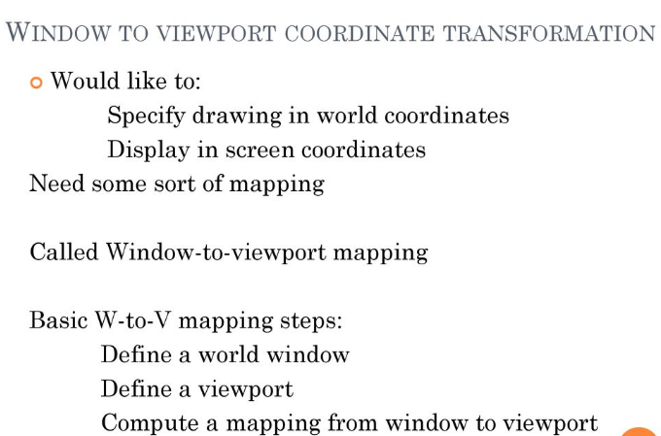
Windowing and clipping

Slide 25
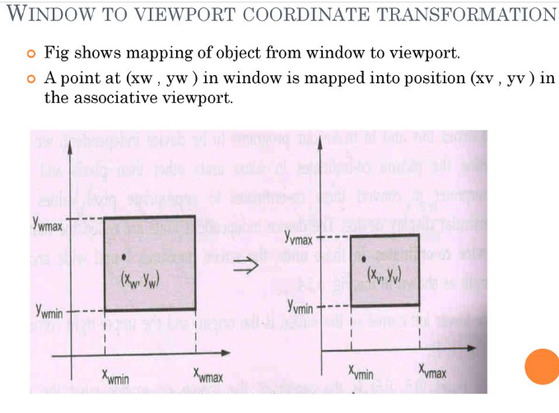
Windowing and clipping

Slide 26
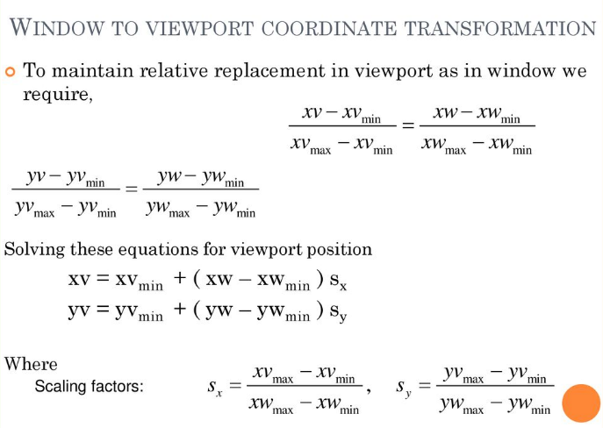
Windowing and clipping

Slide 27
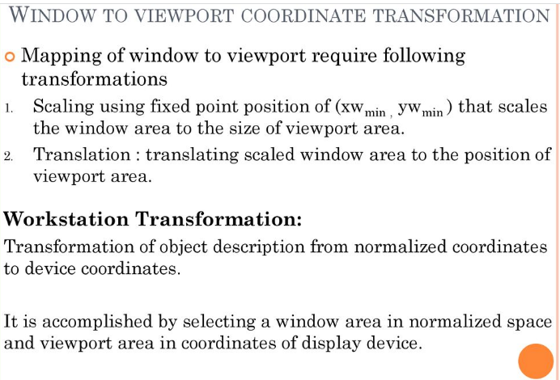
Windowing and clipping

Slide 28
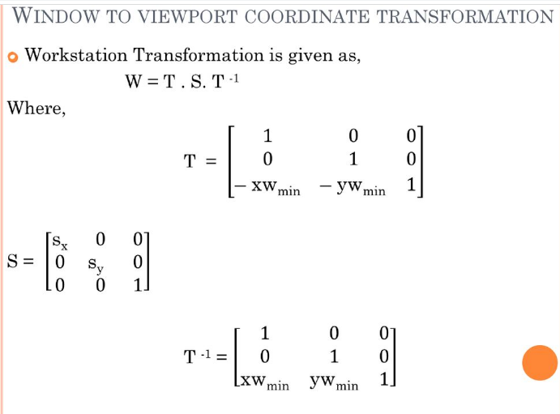
Windowing and clipping

Slide 29
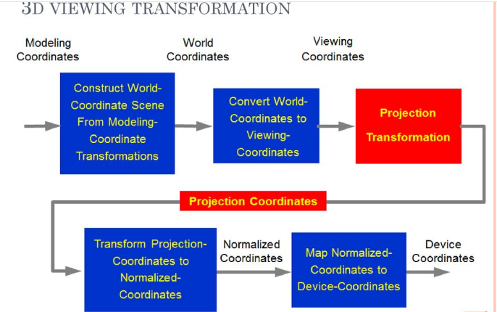
Windowing and clipping

Slide 30
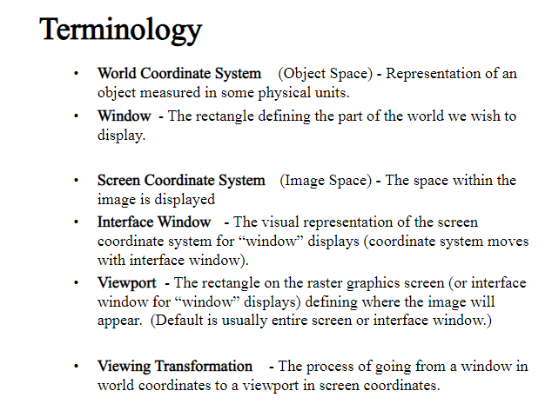
Windowing and clipping

Slide 31
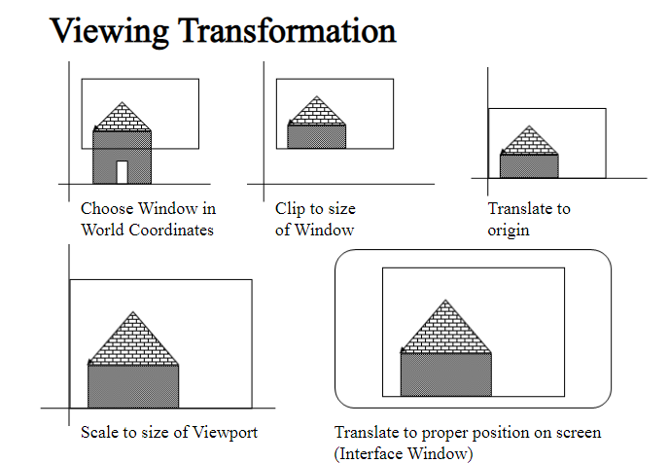
Windowing and clipping

Slide 32
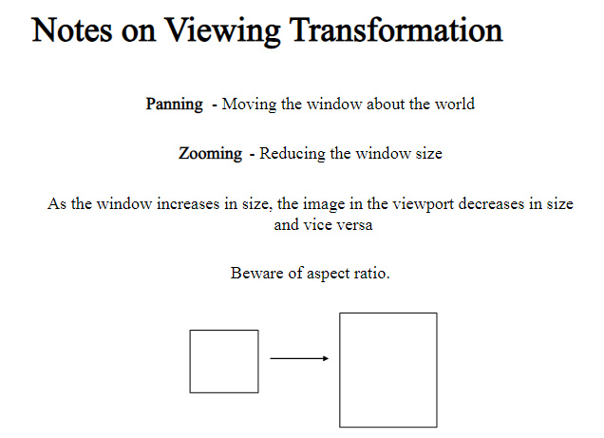
Windowing and clipping

Slide 33
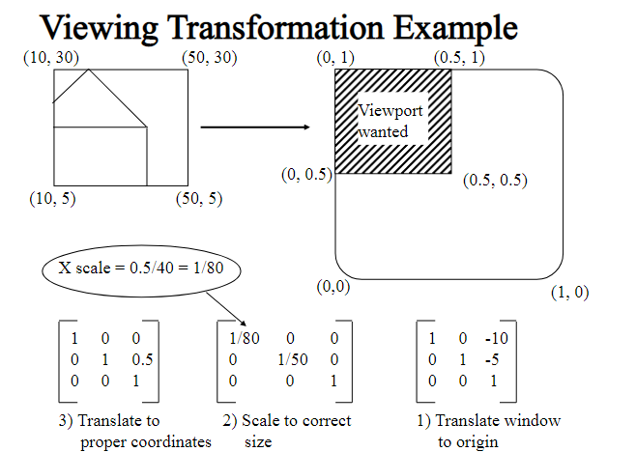
Windowing and clipping

Slide 34
Windowing and clipping

Slide 35
Windowing and clipping

Slide 36
Windowing and clipping

Slide 37
Windowing and clipping

Slide 38
Windowing and clipping

Slide 39
Windowing and clipping

Slide 40
Windowing and clipping

Slide 41
Windowing and clipping

Slide 42
Windowing and clipping

